Slide 1

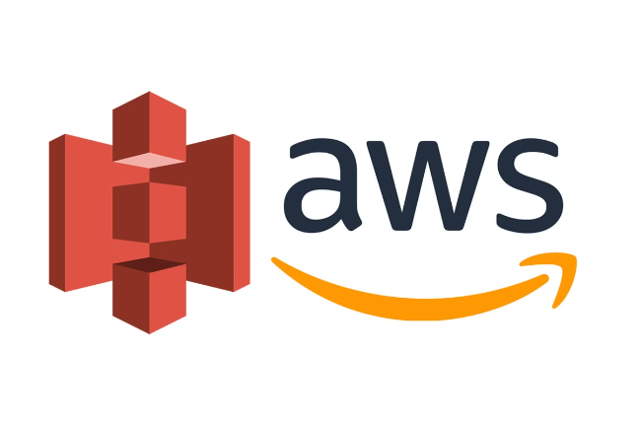

Amazon Simple Storage Service (S3): Scalable Cloud Storage
Amazon Simple Storage Service (Amazon S3) is a scalable
object storage service provided by Amazon Web Services (AWS). It's designed to store and retrieve any amount of data from anywhere on the web. This presentation will explain the key concepts, features, and use cases of AWS S3 for beginners.
by Ram N Java

Slide 2


Key Concepts: Buckets
Container for Objects
Buckets are containers for storing objects (files). Each object is stored in a bucket.
Unique Naming
You must create a bucket before you can store data in S3. Each bucket is unique across the entire AWS system.
Regional Storage
Buckets have a unique name and reside in a specific
AWS region.

Slide 3


Key Concepts: Objects
1
Fundamental Entities
Objects are the fundamental entities stored in S3. An object consists of data, metadata, and a unique identifier.
2
Data Content
The data part is the actual content you are storing (e.g., documents, images, videos).
3
Metadata
Metadata is information about the object (e.g., the date last modified, content type).
4
Object Identification
Each object is identified by a key (name) within a bucket.

Slide 4
Key Concepts: Keys and Regions
Keys
Regions
The key is the unique identifier for an object within a bucket. It's like a file path in a file system. Keys can include slashes to create a directory-like structure.
Regions are geographical areas where AWS data centers are located. You can choose a region to store your buckets. Choosing a region close to your users can reduce latency.

Slide 5

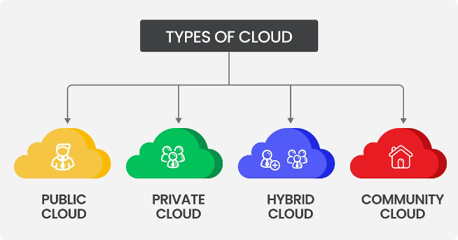
Features of Amazon S3:
Scalability and Reliability
1
Automatic Scaling
S3 automatically scales to handle large amounts of data. You don't need to worry about managing storage infrastructure.
2
High Durability
S3 is designed for 99.999999999% (11 nines) durability, ensuring that your data is highly durable.
3
High Availability
S3 is also highly available, designed for 99.99% availability.

Slide 6


Features of Amazon S3: Security
Multiple Security Features
S3 provides multiple security features, including
access control policies, encryption, and bucket policies.
Identity and Access Management
You can use AWS Identity and Access Management (IAM) to control who can access your data.

Slide 7

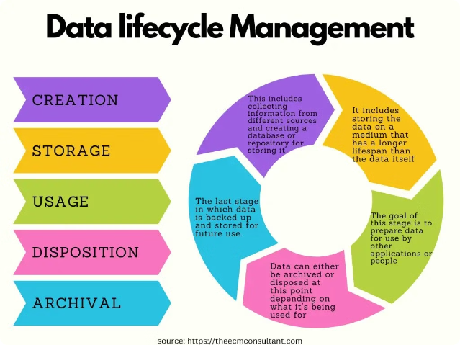
Features of Amazon S3: Data Management
1
Management Tools
S3 offers various tools for managing your data, such as versioning, lifecycle policies, and cross-region replication.
2
Versioning
Versioning allows you to keep multiple versions of an object, which can help with data recovery.

Slide 8
Features of Amazon S3:
Data Transfer and Access
Transfer Methods
Access Control
S3 supports multiple methods for transferring data, including the
AWS Management Console, AWS CLI, SDKs, and REST API.
You can control access to your data using ACLs (Access Control Lists) and bucket policies.

Slide 9

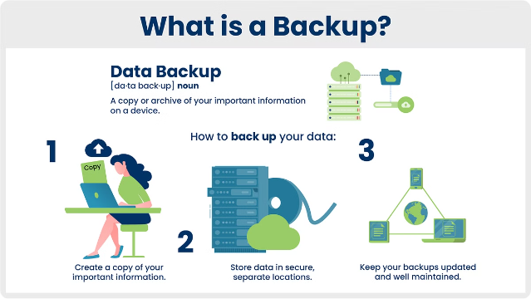
Common Use Cases: Backup and Restore
Reliable Backup Storage
Use S3 to store backup copies of your data. Its durability and availability make it a reliable choice for backups.

Slide 10


Common Use Cases: Data Archiving
Low-Cost Archiving Options
S3 Glacier and S3 Glacier Deep Archive offer low-cost storage options for data archiving.

Slide 11




Common Use Cases: Big Data Analytics
Store Large Datasets
Use AWS Analytics Services
Analyze Data
Store large datasets in S3
Analyze the data stored in S3
Use AWS analytics services like Amazon Athena and Amazon Redshift

Slide 12

Common Use Cases: Static Website Hosting
Direct Hosting from S3
Host static websites directly from an S3 bucket. S3 can serve HTML, CSS, JavaScript, and other files.

Slide 13





Common Use Cases:
Content Distribution
Store Content in S3
Use S3 to store your content
Integrate with CloudFront
Use S3 with Amazon CloudFront
(a Content Delivery Network)
Global Distribution
Distribute content globally with low latency

Slide 14
Getting Started with Amazon S3
Create an AWS Account
1
Sign up for an AWS account if you don't already have one.
2
Create a Bucket
Go to the AWS Management Console, navigate to S3, and create a new bucket.
Upload Objects
3
Upload files (objects) to your bucket using the console, AWS CLI, or SDKs.
4
Set Permissions
Configure bucket policies and ACLs to control who can access your data.
Access Your Data
5
Use the AWS Management Console, AWS CLI, or APIs to retrieve and manage your data.

Slide 15


Conclusion:
The Power of Amazon S3
Versatile Storage Solution
Amazon S3 is a versatile and powerful storage service that can handle a wide range of use cases.
Scalability and Durability
Its scalability, durability, and extensive feature set make it a popular choice for individuals and businesses alike.
Foundation for Success
By understanding the basics of buckets, objects, and keys, you can start leveraging S3 for your storage needs.

